Slide 1
Microsoft Teams for Education
Quick Start Guide
New to Microsoft Teams for Education? Use this guide to learn the basics.
Teams is available as an app for Windows, Mac, Linux, Android, and iOS. You can also open Teams on the web without any download necessary, although the apps provide expanded features in comparison to the web version.
Navigate to this link to get started. You can either download Teams directly to your desktop or receive a link to download the mobile app.
Sign in
Once you’ve installed the app, you’ll need to sign in with your university email and password.
In Windows, click Start > Microsoft Teams.
On Mac, go to the Applications folder and click Microsoft Teams.
On mobile, tap the Teams icon.

Slide 2
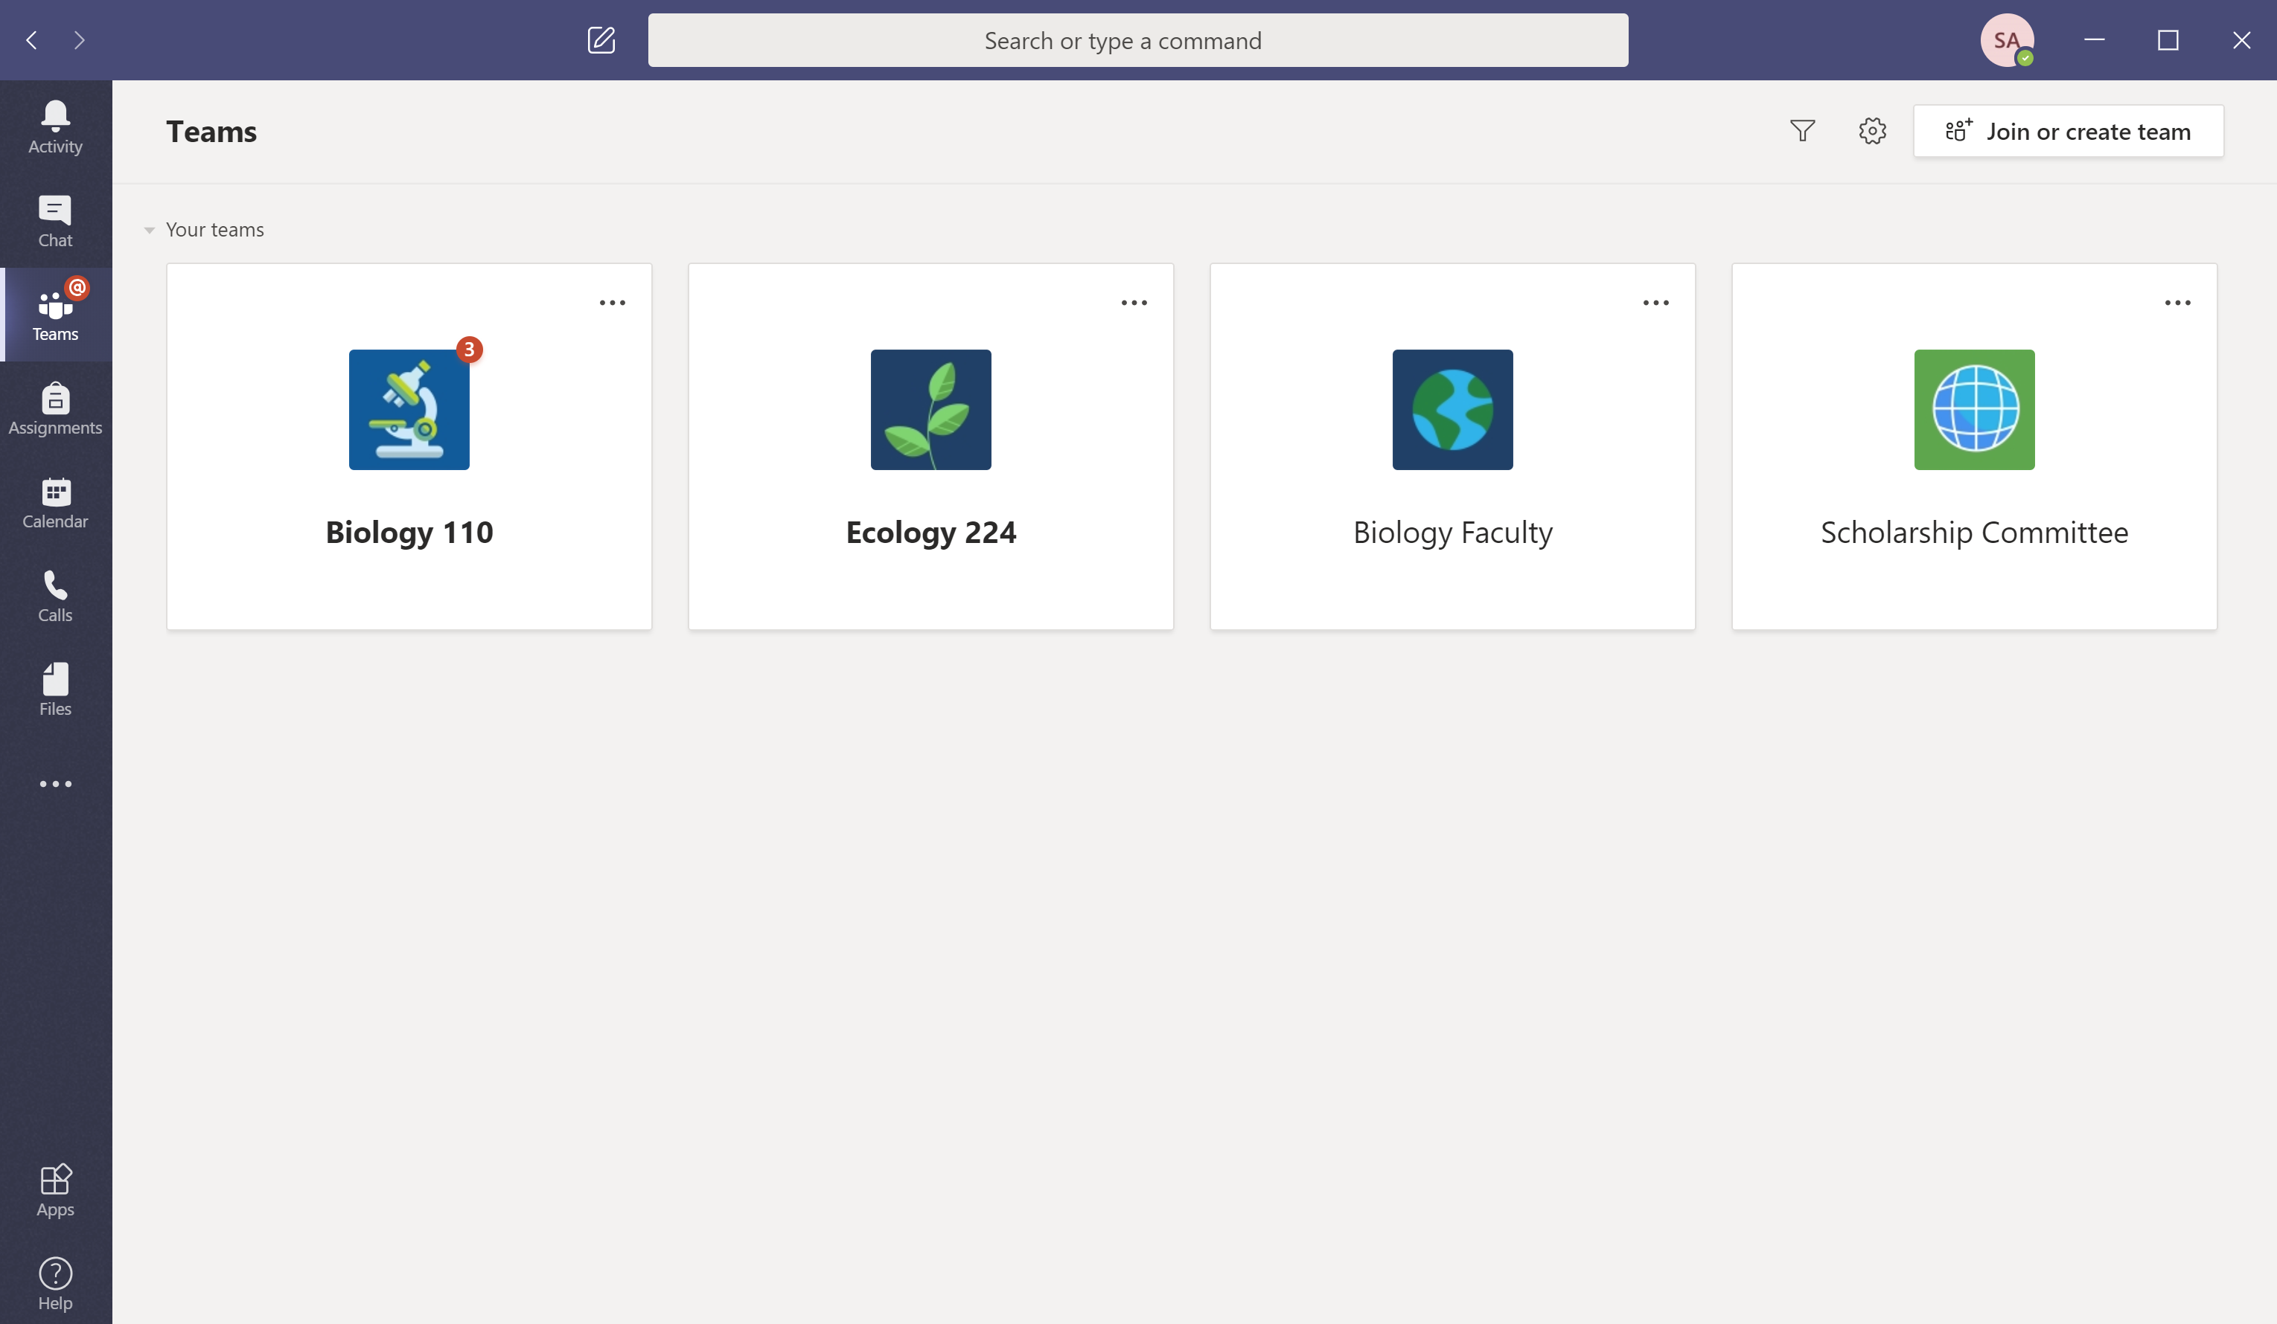
Microsoft Teams for Education
The basics
Teams is divided into tabs on the left side of your screen.
Start a new chat
Launch a private one-on-one or small group conversation.
Use the command box
Search for specific items or people, take quick actions, and launch apps.
Manage profile settings
Change app settings, change your pic, or download the mobile app.
Navigate Microsoft Teams
Use these buttons to switch between Activity Feed, Chat, your Teams, Assignments, Calendar, and Files.
Join or create a team
Find the team you’re looking for, join with a code, or make one of your own.
Manage your team
Add or remove members, create a new channel, or get a link to the team.
View and organize teams
Click to see your teams. Drag team tiles around to reorder them.
Access assignments
Keep track of class assignments your students have submitted.
View your team
Click to open your class or staff team.
Find personal apps
Click to find and manage your personal apps.
What is a team?
You can create or join a team to collaborate with a certain group of people. Have conversations, share files and use shared tools with the group – all in one place. That group could consist of a class of students and faculty, a group of staff and faculty collaborating on a topic, or even a group for a student club or other extracurriculars.
Add apps
Launch Apps to browse or search apps you can add to Teams.

Slide 3
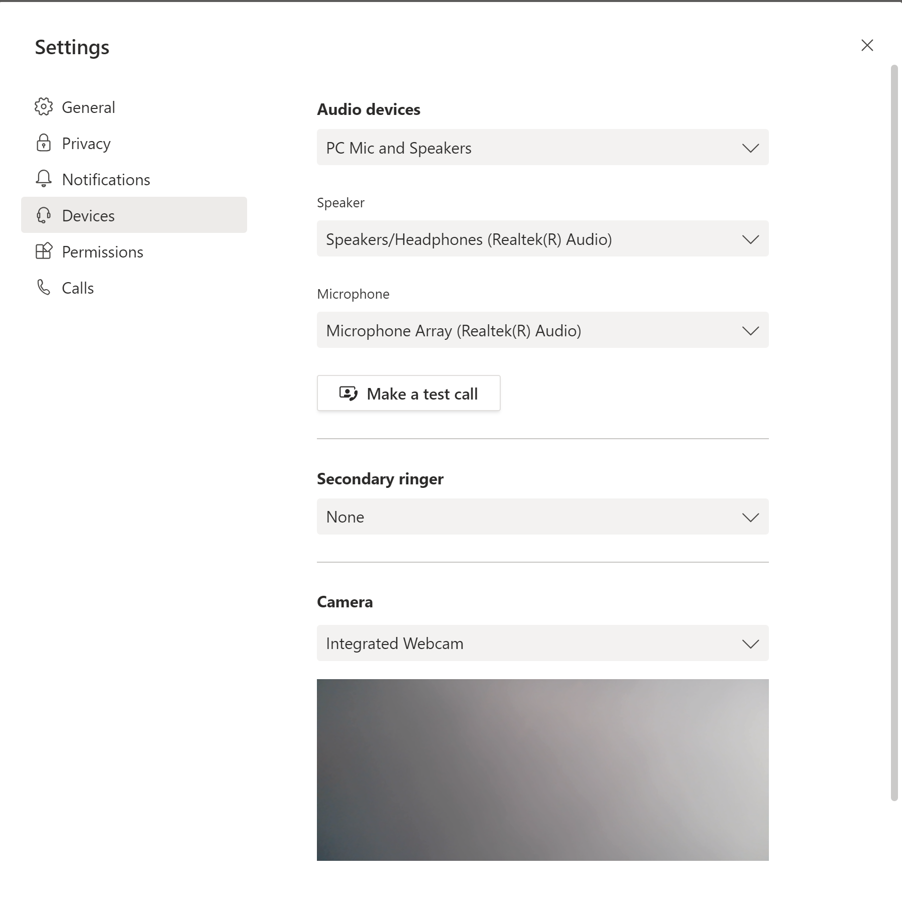
Microsoft Teams for Education
Start a conversation
With the whole team... Click Teams, pick a team and channel, start your message with an @ mention and write your message then click Send.
Mentions direct the communication notifications to:
@person's name sends each person mentioned a notification
@channel sends all who have the channel as 'show' a notification
@team sends everyone in the team a notification
With a person or group... Click Chat, select new chat and type the name of the person or multiple people in the To field, write your message, and click Send.
Make a test call before meetings
Click your profile icon in the top left, navigate to Settings, click Devices, and click Make a test call. This will ensure that your microphone and speakers are working before you join a meeting or class session. You can also test your webcam in this tab. Make a test call requires you use the installed app on your laptop or desktop—download here.

Slide 4
Microsoft Teams for Education
Search for things
Type a phrase in the command box at the top of the app and press Enter. Then select the Messages, People, or Files tab. Select an item or click Filter to refine your search results.
Add apps
Click Apps on the left. Here, you can select apps you want to use in Teams, choose the appropriate settings, and Add.
Useful apps for Higher Education include…
GitHub to browse issues and pull requests for your GitHub repositories
Kahoot to share interactive learning content with colleagues and students
Adobe Creative Cloud to find, view, and share Adobe CC assets within Teams
ClickView to manage all of your institutions video content
Quizlet to make simple learning tools that let your students study anything
MindMeister for professional, versatile mind mapping software
And many more you can explore on the web here!
Find your personal apps
Click More added apps to see your personal apps. You can open or uninstall them here. Add more apps under Apps.

Slide 5
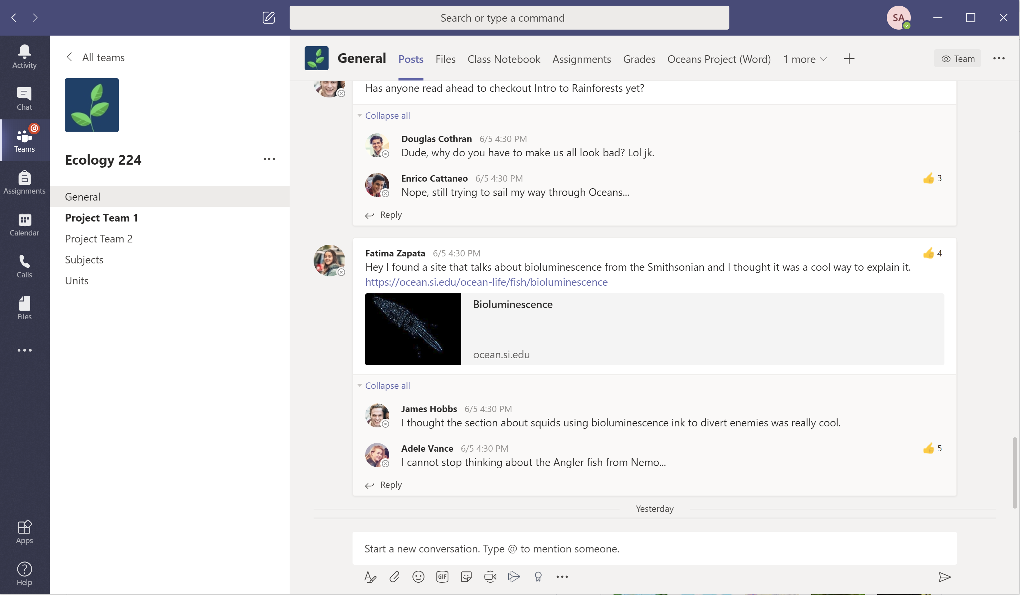
Microsoft Teams for Education
Class teams
Class teams provide special capabilities tailored for teaching and learning
Add channels and manage your team
You can change team settings, add members to the class team and add channels .
Access files
View files that have already been shared in your channel.
Open Class Notebook
Class Notebook is a digital binder you can use in your class to take notes and collaborate.
Open Assignments and Grades
Assignments allows professors to create and distribute assignments. Students can complete and turn in their assignments without leaving the app. Professors can use the Grades tab to provide feedback on assignments and track student progress.
Add tabs
Explore and pin applications, tools, documents and more to enrich your class. We’re constantly adding more education specific tabs. Check back often.
Every team has channels
Click one to see the files and
conversations about that
topic, class unit, or week in the course. You can even have private channels for group projects!
Every team comes with a General channel. Open channel settings to add new channels, manage notifications and other settings.
Share files
If you upload a file in a chat message, Teams automatically creates a live version everyone can collaborate on.
Start a discussion with the class
Type and format you message or announcements here. Add a file, emoji, GIF, or sticker to liven it up!
Format your message
Add a subject, format text, convert the message to an announcement, post across multiple teams or control who can reply and more.
Add more messaging options
Click here to add new messaging capabilities like polls, Praise, and more to enrich classroom discussion.

Slide 6
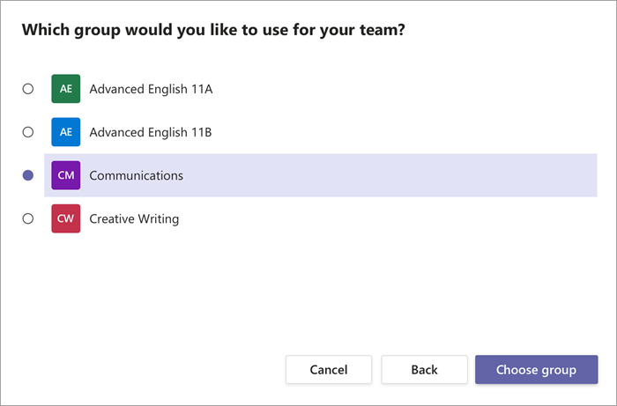
Microsoft Teams for Education
Creating class teams
Class teams provide capabilities tailored for teaching and learning
Send join link
Click the ellipsis and select Get link to team
Create team code
Under Settings, select Team code and click Generate for a 6-character join code
Rely on teams created automatically by IT
Your IT Admin may create groups based on your classes and their rosters using School Data Sync (SDS) or another method. Choose the group as you create your team to automatically add students and set up your class team.

Slide 7
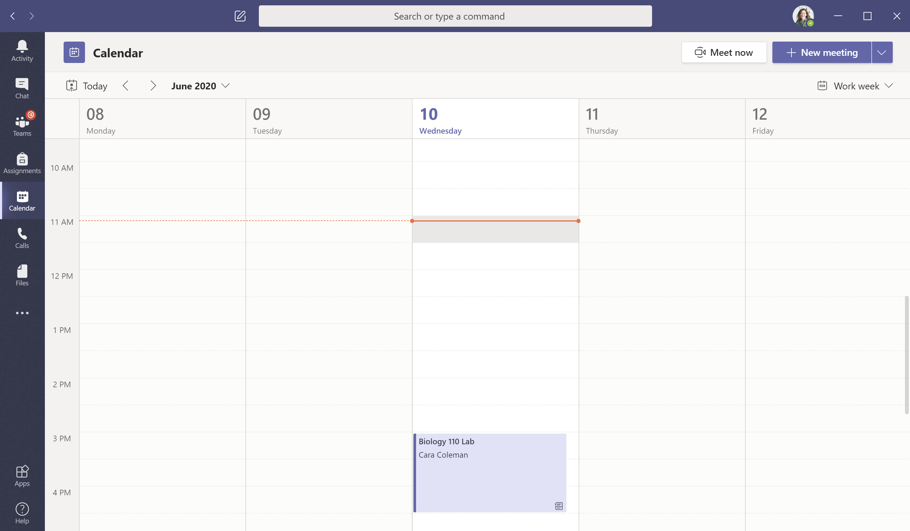
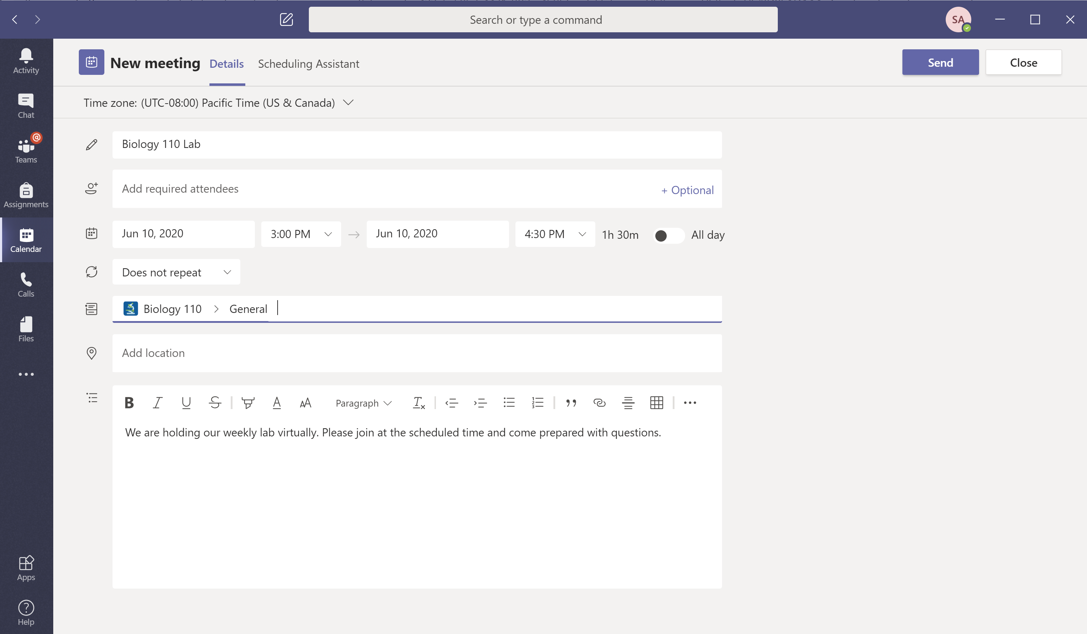
Microsoft Teams for Education
Schedule a meeting with your team or class
Hold classes, staff collaboration meetings, or trainings over online meetings
Start a meeting right away
Add participants directly to a meeting that starts right away.
Add new meeting
Schedule a new meeting for live discussion with up to 250 people or schedule a live event for a broadcasted event with a wider audience.
Invite individuals to a meeting
Invite one or more individuals to your meeting. Meeting recordings and resources shared during the meeting will be organized within the meeting history item in your Chat view.
Invite a channel to a meeting
Invite your whole class or working group to a meeting by selecting a channel to host the meeting. Meeting recordings and resources shared during meetings will be organized within the selected channel.

Slide 8
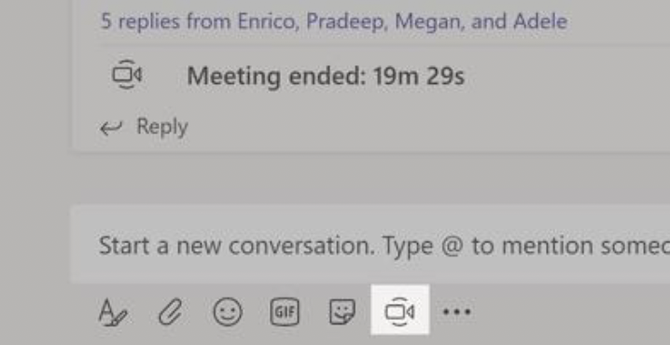
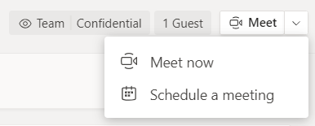
Microsoft Teams for Education
Schedule a meeting with your team or class
Hold classes, staff collaboration meetings, or trainings over online meetings
Click Meet now at the top of the Channel header to start a live meeting in a channel.
If you click Reply to a message, then the meeting will be attached to that conversation. If you wish to start an independent meeting that is not tied to a channel, then follow the instructions on the previous page by selecting Calendar > New Meeting.
You can invite people to the meeting or ask them to join it directly from the channel.
Select Meet now to start the meeting right away or Schedule a meeting to schedule the meeting for the future. Members of the channel will see an invitation for the meeting in their calendar if you decide to schedule it for later.
Notes:
New version as of 2020-04-27

Slide 9
Microsoft Teams for Education
Roles in an online meeting
Every participant in a meeting is assigned a role as a presenter or attendee. A participant's role controls what they can do while in a meeting.
Capabilities | Organizer/Presenter | Attendee
Speak and share video | ✓ | ✓
Participate in meeting chat | ✓ | ✓
Privately view a PowerPoint file shared by someone else | ✓ | ✓
Share content | ✓
Mute other participants | ✓
Remove participants | ✓
Admit people from the lobby | ✓
Change the roles of other participants | ✓
Start or stop recording | ✓

Slide 10
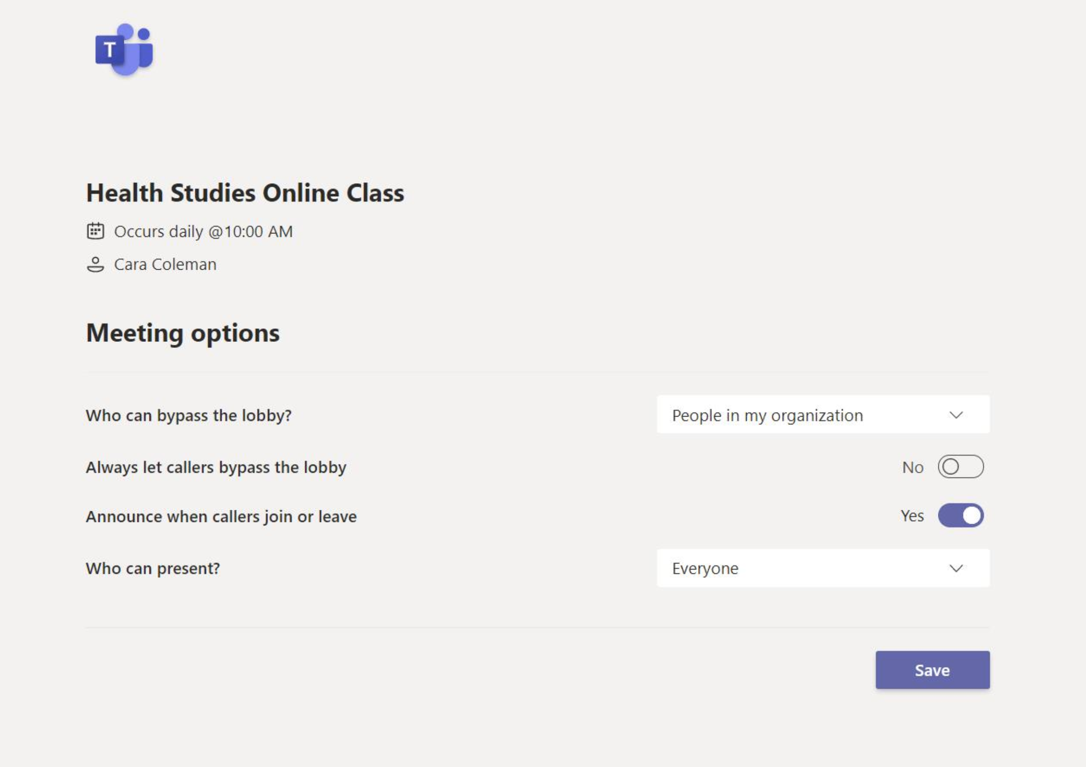
Microsoft Teams for Education
Set meeting roles through your Meeting options
Meeting options allow you to control if meeting participants join your meetings as attendees or presenters.
Control who can enter the meeting directly.
Use the virtual meeting lobby so that participants wait to be admitted to the meeting instead of joining immediately.
Occurs every Wed @ 3:00 PM
Control who joins the meeting as a presenter or attendee.
Select Only Me to designate all other participants as attendees. This is the safest set-up for meetings held in a classroom setting.
If you expect to have more than one presenter in your meeting, select Specific people and pick the other participants who should join as presenters. Select Everyone if you want all participants to join the meeting as a presenter.
Go to your Calendar and navigate to the meeting you'd like to update. Click or tap Meeting options near the meeting join link to open your Meeting options.
Meeting options may be controlled by your IT administrator’s policy settings.

Slide 11
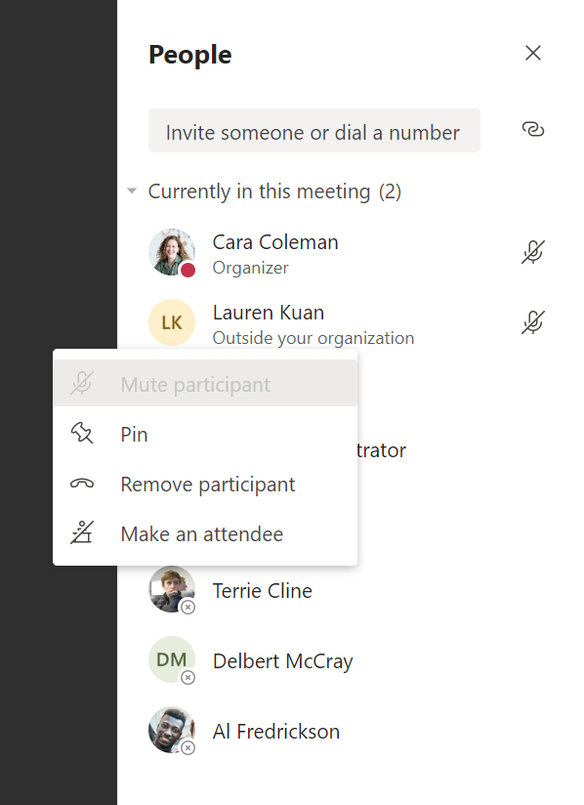
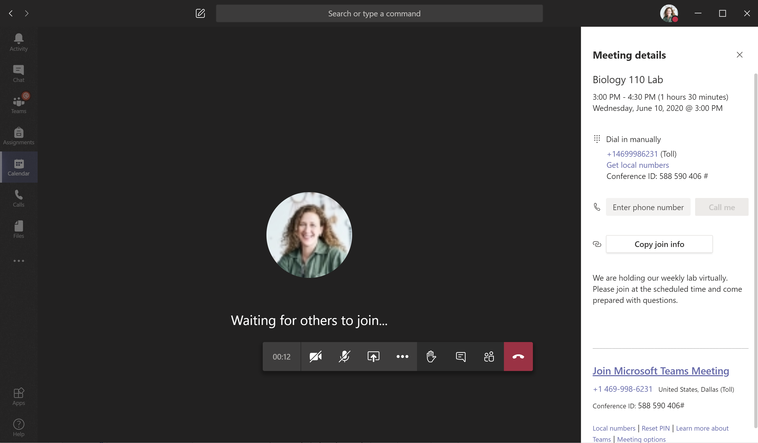
Microsoft Teams for Education
Change roles during a meeting
Every participant in a meeting is assigned a role as a presenter or attendee. A participant's role controls what they can do while in a meeting.
To change a participant’s meeting role, click or tap Show participants in your call controls. Right-click on the participant whose role you want to change. Select Make an attendee or Make a presenter.
To quickly access your Meeting options and change the meeting role settings for both current participants and anyone joining your meeting in the future, click or tap More actions in your call controls, then Show meeting details. You can find the link to your Meeting options near the join link for the meeting.

Slide 12
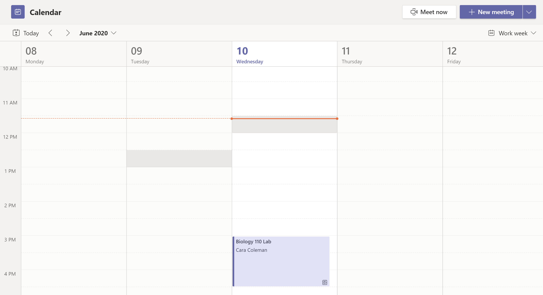
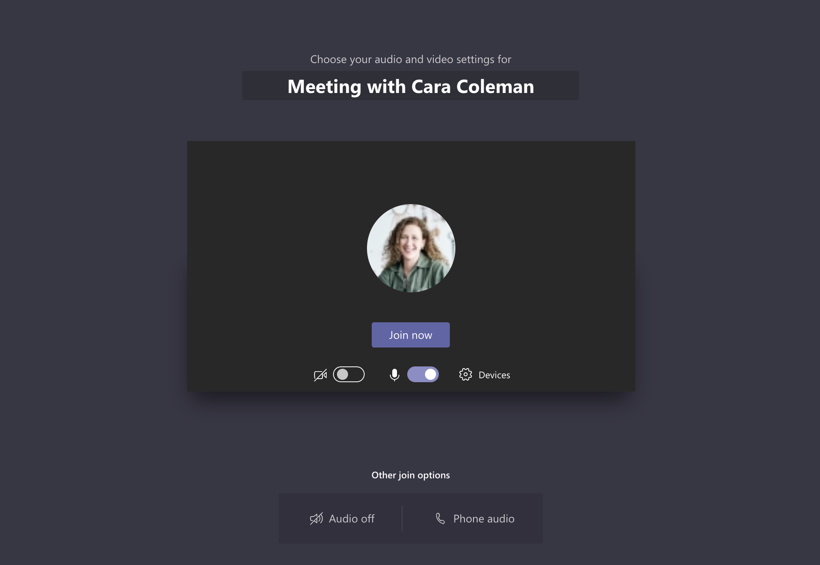
Microsoft Teams for Education
Join a meeting
Hold classes, staff collaboration meetings, or trainings over online meetings
Open the meeting and click Join to join the meeting.
Double check your audio and video input, turn on the camera, and unmute your microphone to be heard. Select Join now to enter the meeting.
Find the meeting invitation in the channel of your team or on your Teams calendar.

Slide 13
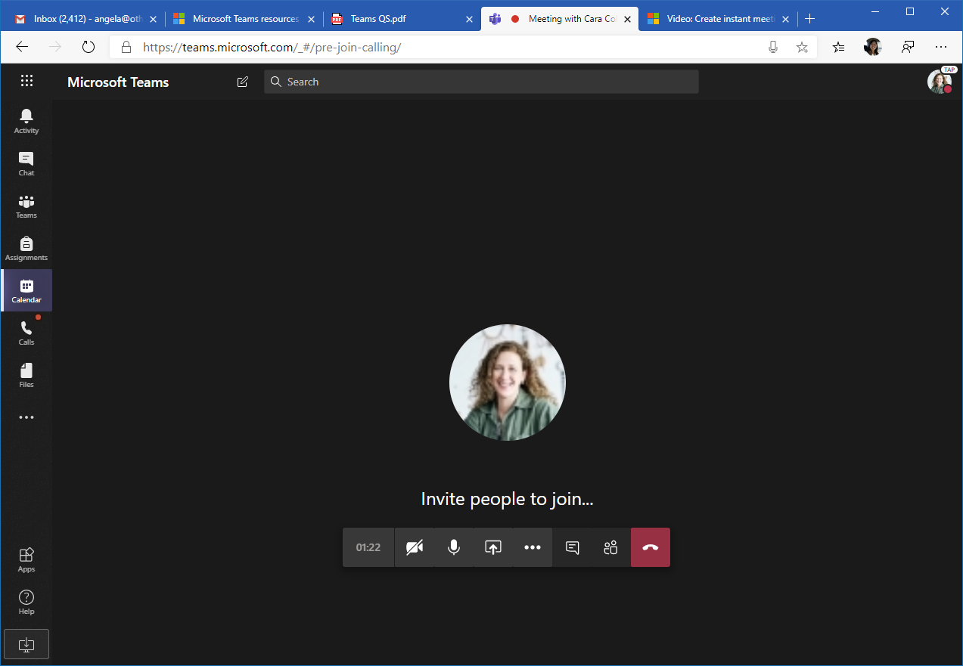
Microsoft Teams for Education
Participate in a meeting
Share video, voice, or your screen during the online call.
Send chat messages
Send chat messages, share links, add a file, and more. Resources you share will be available after the meeting.
Leave the meeting
The meeting will continue even after you have left.
Turn your video feed on and off.
Mute and unmute yourself.
Add participants to the meeting.
Share your screen and sounds from your computer.
Access additional call controls
Start a recording of the meeting, change your device settings, and more.

Slide 14
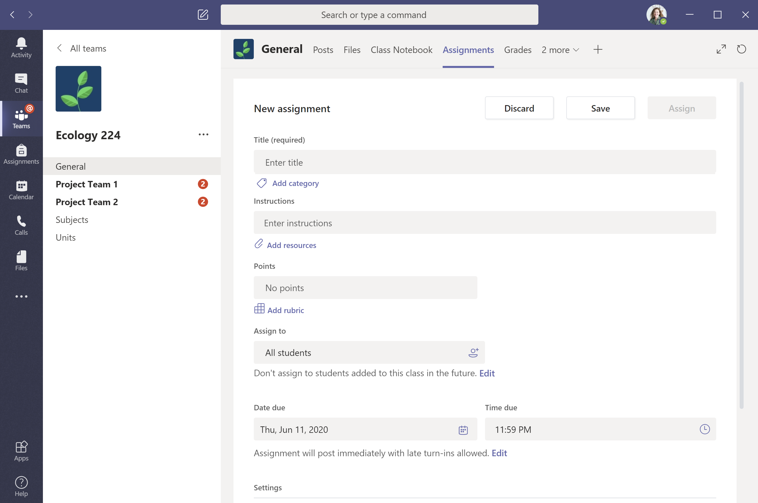
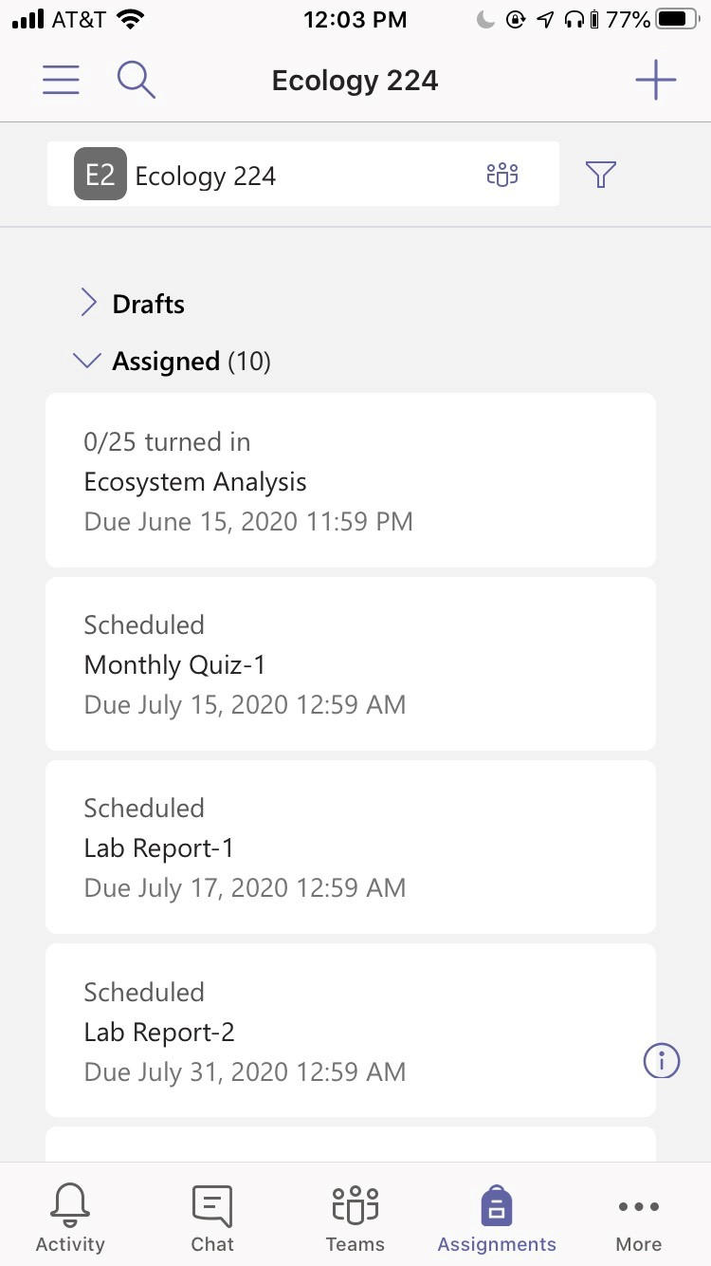
Microsoft Teams for Education
Assignments
Create learning activities for students with integrated Office applications.
View upcoming assignments
View both upcoming and turned in assignments by class, or view them across all your classes. Selecting an assignment will allow you to turn it in or view feedback and scores.
Add resources
Customize the assignment with content from OneDrive, your device, links, and more.
Assign to classes or individuals
Assignments can be distributed to multiple classes or personalized to the individual student.
Add a grading rubric
Use the rubrics tool to create customizable, reusable rubrics for students to reference and for you to evaluate their work.
Edit due dates, close date, and schedule to assign
Customize all the dates and times that are important to the assignment.

Slide 15
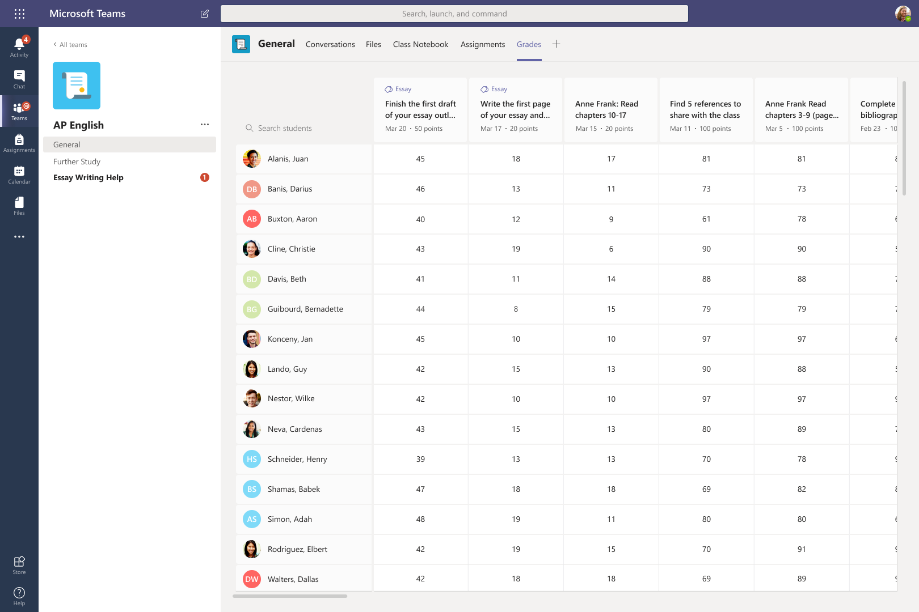
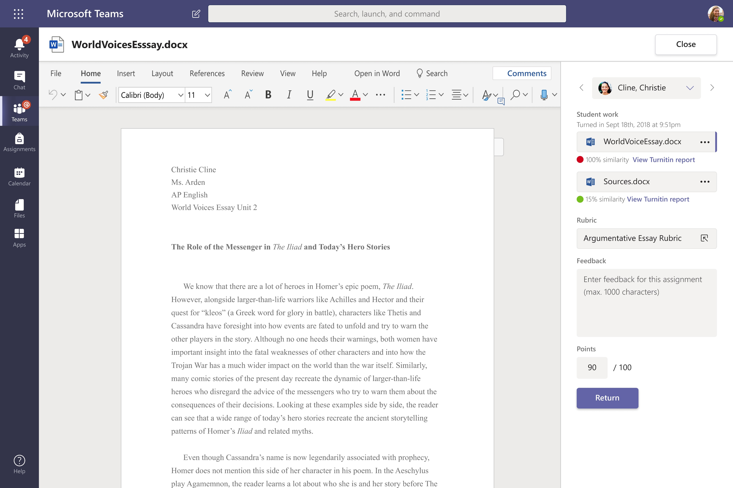
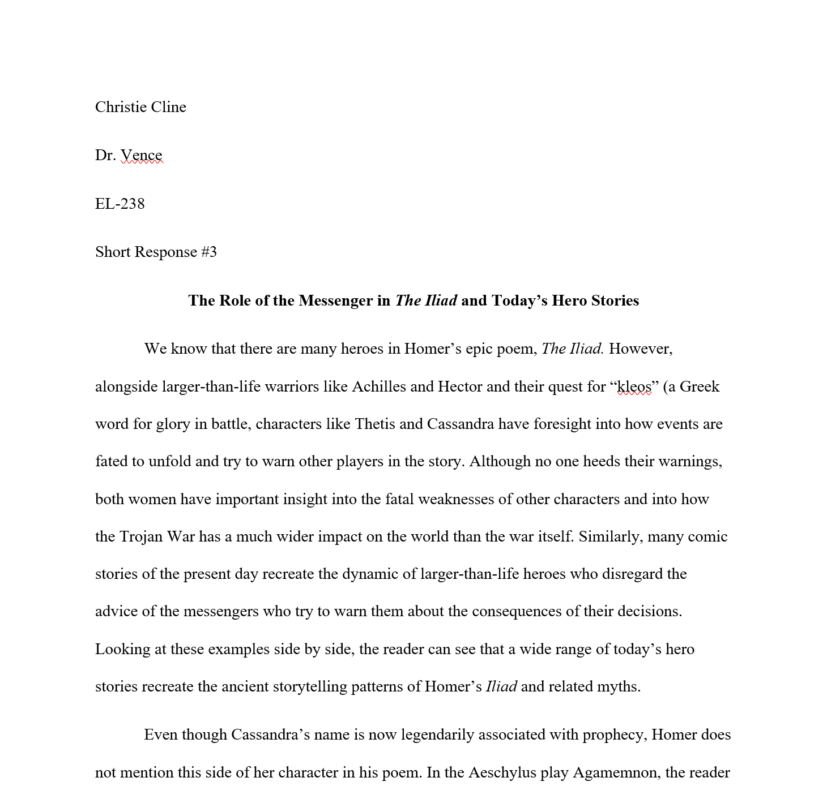
Microsoft Teams for Education
Grades
Leave feedback for students, grade, and track student progress in the Grades tab.
English 238
See grades across all assignments and students
Each of your class teams has a Grades tab where you can view assignments at a glance, as well as track how individual students in your class are progressing.
Return and review assignments using the feedback loop
Leave comments, make edits, grade with criteria/standards, check for similarity, and more in the grading view.

Slide 16
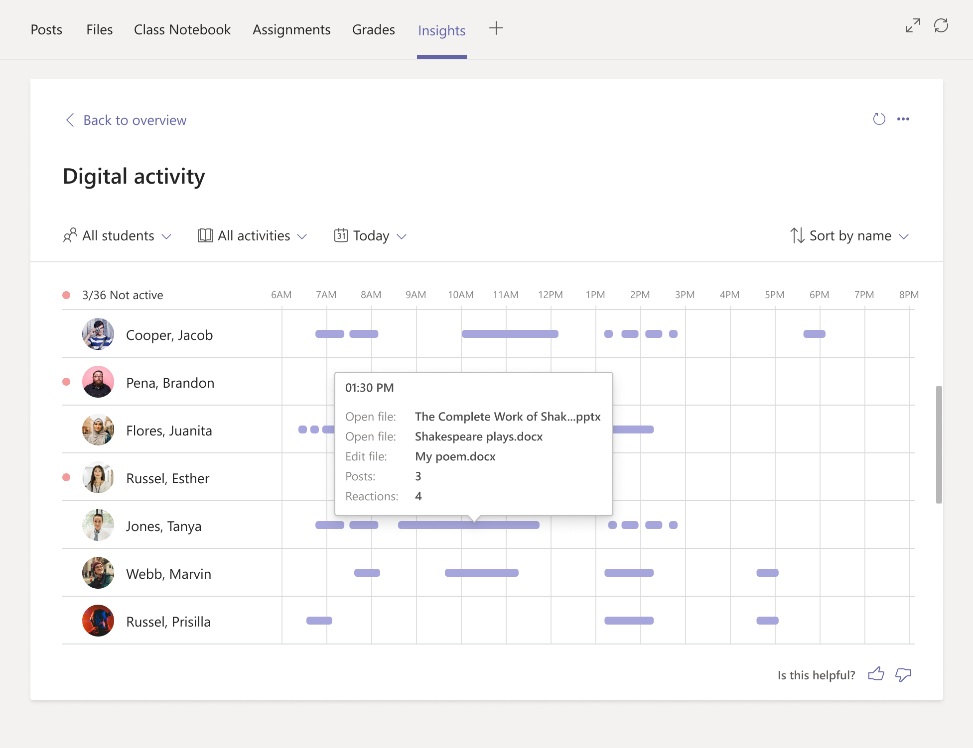
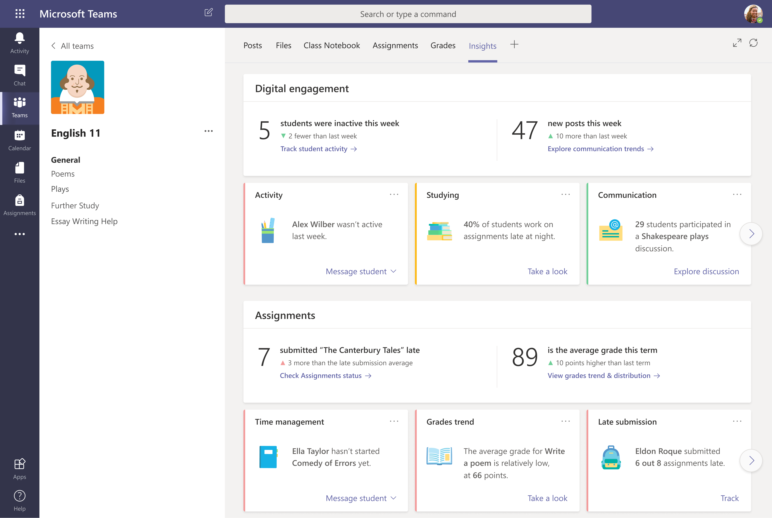
Microsoft Teams for Education
Get insights
Coming Calendar Quarter 4 2020: Monitor class statistics like digital activity, preferred study times, discussion participation, grade trends, late submissions, and more.
Click “Insights”
Get an initial overview of important engagement and assignment statistics
Shakespeare 101
Explore each category
Click the link at the bottom of each box to dive deeper into the statistics or take other next steps

Slide 17
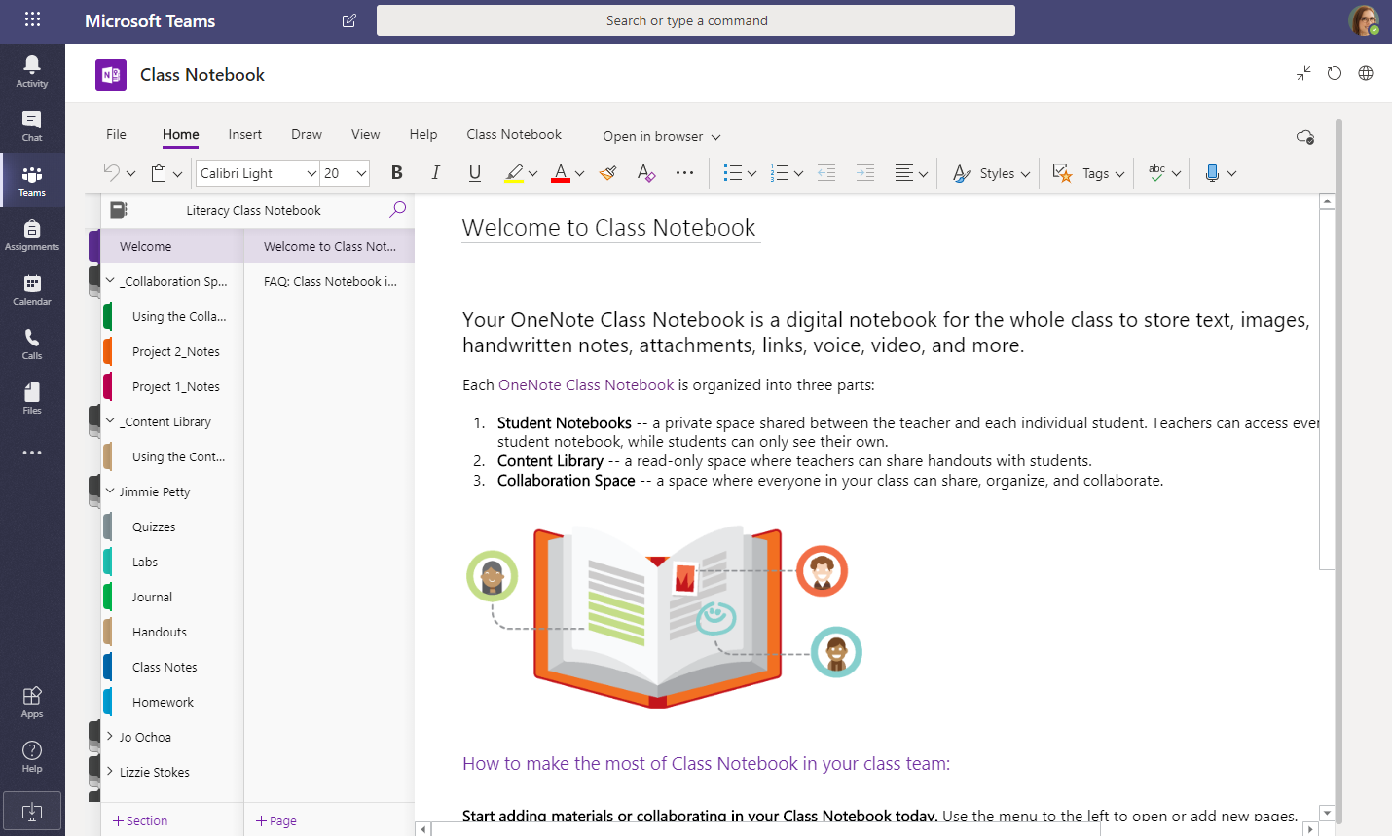
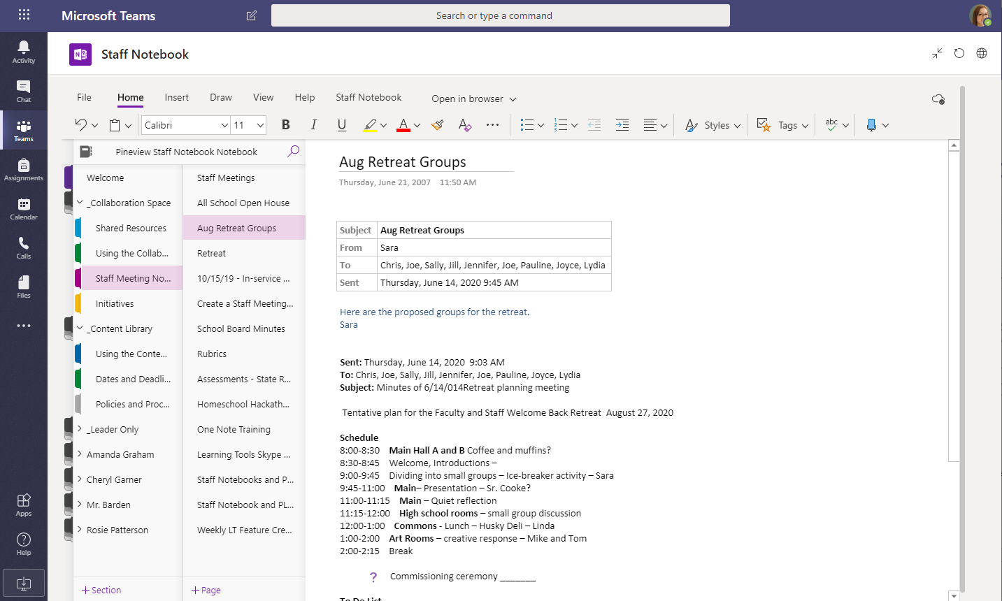
Microsoft Teams for Education
OneNote Class and Staff Notebooks
A digital binder to use in your class to take notes and collaborate
Personal notes, class notes, and collaboration
OneNote Class Notebooks have a personal workspace for every student, a Content Library for handouts, and a Collaboration Space for lessons and creative activities.
Great for staff meeting notes, brainstorming, and classroom observations
OneNote Staff Notebooks have a personal workspace for every staff member or instructor, a Content Library for shared information, and a Collaboration Space for everyone to work together, all within one powerful notebook.

Slide 18
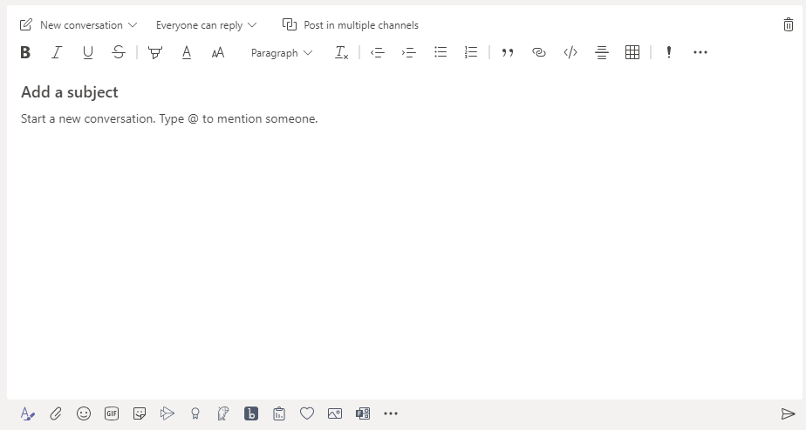
Microsoft Teams for Education
Enrich your channel posts
Create classroom announcements and posts. Edit your post to get your students' attention, control who replies, and post across multiple channels.
Change your message type
Select if you want to start a new conversation topic or post an announcement.
Control who can reply
Allow everyone to reply to your post or limit replies to moderators only.
Post in any channel or team
Post your message in any of your teams and channels all at once. Great for broadcasting an important announcement!
Change the importance of your message
Mark your message as important if you want to draw more attention to the post.
Format your text
Change text color, format, and style.
Add a subject
Keep the topic of your new post clear by adding a subject.
Add a subject
Click here to enter a rich format mode for your message.

Slide 19
Microsoft Teams for Education
Make video and audio calls
Click Video call or Audio call to call someone from a chat. To dial a number, click Calls on the left and enter a phone number. View your call history and voicemail in the same area.
@mention notifications
To get someone’s attention, type @, then their name (or pick them from the list that appears). Type @team to message everyone in a team or @channel to notify everyone who has that channel set to 'show'.
Reply to a conversation
Channel conversations are organized by date and then threaded. Find the thread you want to reply to, then click Reply. Add your thoughts and click Send.
Add Teams meetings to your LMS
Teams meetings can be added to Blackboard, Moodle, Canvas, Schoology, Brightspace by D2L, and itsLearning. Look for the Create meeting link button in your LMS, and read this guide to learn more about where to find it in each platform.

Slide 20
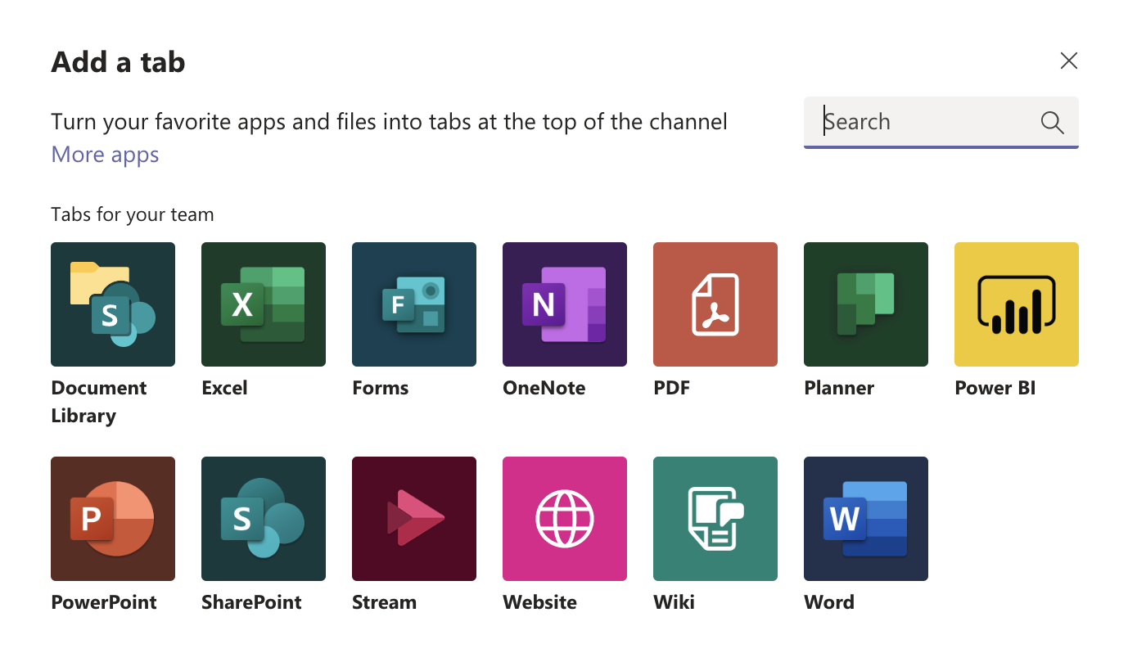
Microsoft Teams for Education
Stay on top of things
Click Activity on the left. The Feed shows you all your notifications and everything that's happened lately in the channels you follow. This is also where you'll see notifications about your assignments.
Share a file
Click Attach under the box where you type messages, select the file location and then the file you want. Depending on the location of the file, you’ll get options for uploading a copy, sharing a link, or other ways to share.
Add a tab in a channel
Click + by the tabs at the top of the channel, click the app you want, and then follow the prompts. Use Search if you don’t see the app you want.
Work with files
Click Files on the left to see all files shared across all of your teams. Click Files at the top of a channel to see all files shared in that channel. Click More options ... next to a file to see what you can do with it. In a channel, you can instantly turn a file into a tab at the top!

Slide 21
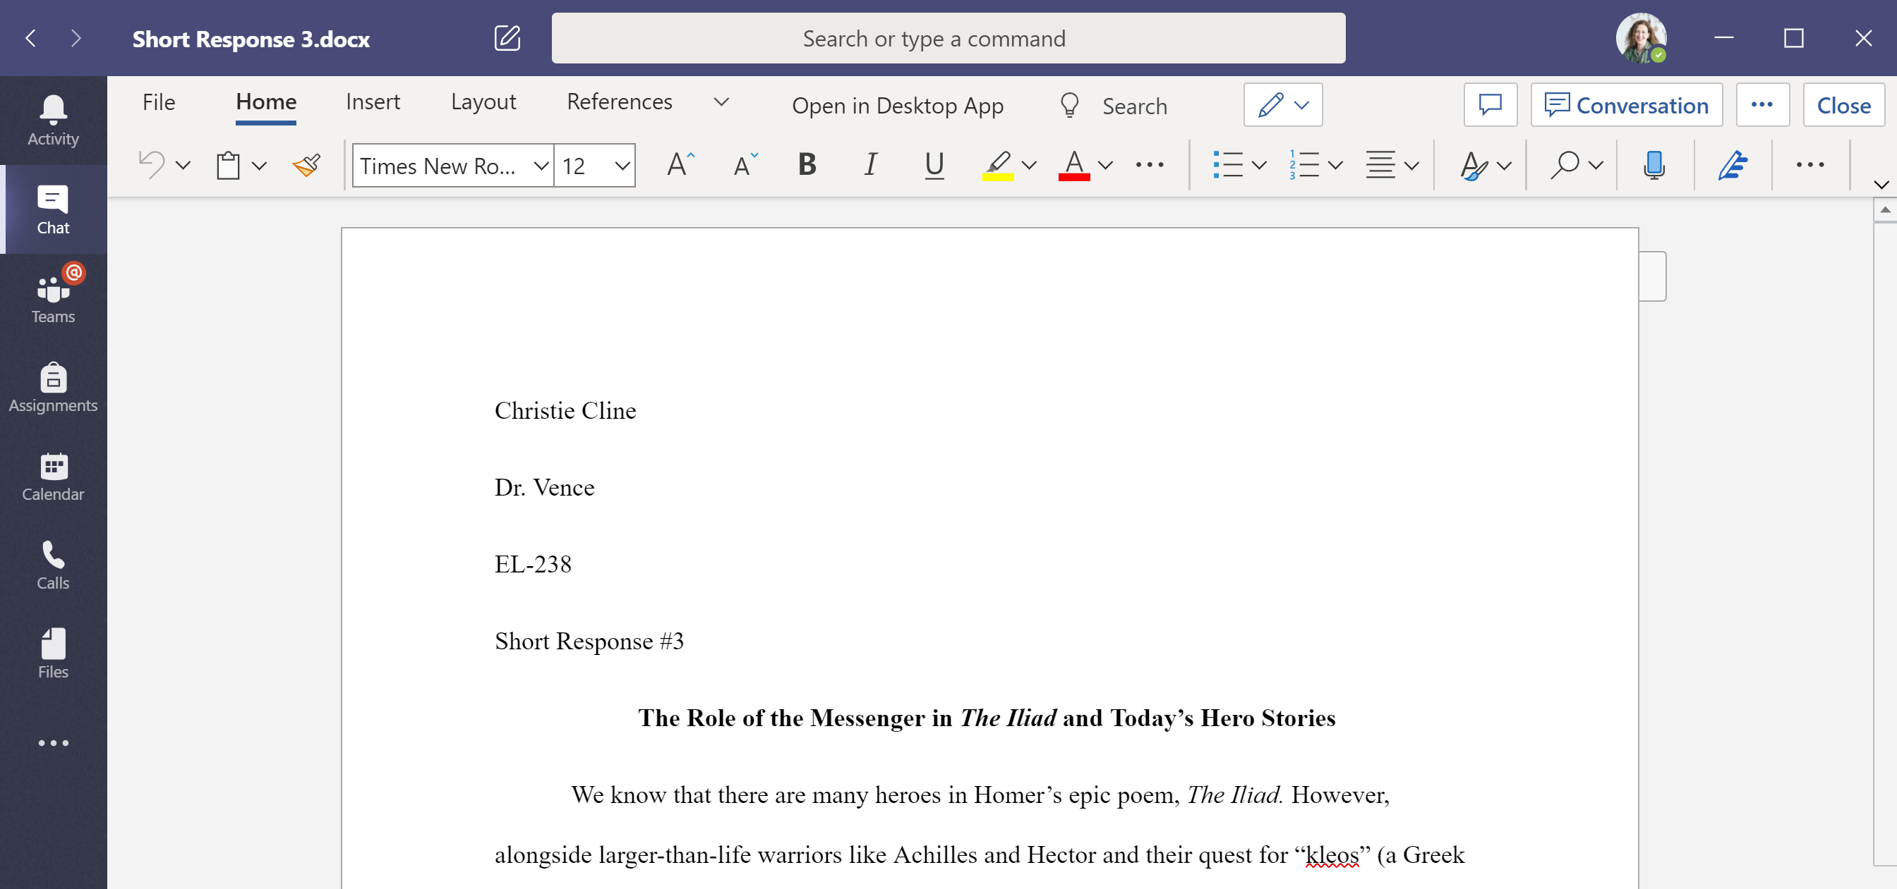
Microsoft Teams for Education
Collaborate with Office 365 apps
Open apps for Office 365 solutions like Word, Excel, PowerPoint, and more to collaborate on live versions of files within Teams.
Next steps with Microsoft Teams
Get how-to guidance for teaching and learning with Teams. You can also click the Help icon in Teams to access help topics and training.
Articles with how-to guidance for teaching in Teams.
1-hour online courses in the Microsoft Educator Center:
How teachers use Teams in their professional lives- Transform Learning with Microsoft Teams.
Teaching in Class Teams-Crafting a Collaborative Learning Environment with Class Teams.
Access the web version
Navigate to office.com to access the online version of Office 365 apps, including Teams, in situations where you can’t access desktop or mobile apps.
Get other Quick Start Guides
To download our free Quick Start Guides for your other favorite apps, go to https://go.microsoft.com/fwlink/?linkid=2008317.

