Slide 1
Usage Guidance
  We’ve created an easy-to-use package of assets for you to send out to incoming students, to help them get started with their complimentary Office 365 products. Included in this package are several flyers:
  Getting Started Guide: Summary of the flyers to follow
  Surface Flyer: Overview of available Surface devices and discounts for students
  Office 365 Flyer: Instructions on downloading and setting up Office 365
  Teams Flyer: Explanation of how Teams can be used as a central hub for education, with a breakdown of various features
  Microsoft Skills Flyer: Overview of Office 365 features, plus other available solutions, with copious links to free online resources for learning and skill development
  Device Setup Flyer: Description of available devices (including both Surface and general Windows 10 devices), followed by instructions for setting up a new device and moving over files and favorites
  Navigate to Slide Master view and follow the directions in the arrows to customize the assets with your own logo and colors. Delete the arrows after customizing. In addition to Slide Master, there is one customization direction on Slide #12.

Slide 2
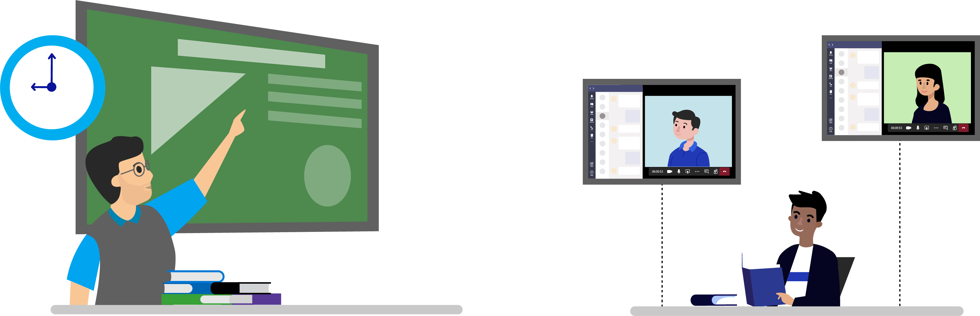


Welcome back for the 2020-21 school year! We’ve partnered with Microsoft to set you up with free software that helps you succeed—no matter where you are.
Find the device that’s right for you
Overview: Students save up to 10% on Surface devices. Find the perfect device for your needs and start customizing your learning with the power and creativity of Surface.
Download your complimentary Office 365 subscription
Overview: You get Office 365 for free—including Microsoft Teams, Word, Excel, PowerPoint, and OneNote. Get started today with the Office 365 download guide.
Use Microsoft Teams, a hub for your complete education experience
Overview: Microsoft Teams is your hub to connect with peers and professors, video chat, complete assignments, access apps, and much more in one highly secure location.
Learn how to use Office 365 and other Microsoft tools
Overview: Learn tips and tricks about the Microsoft suite of products and take full advantage of the complimentary productivity software available to you on any device.
Move your favorites, files, and apps to your new device
Overview: If you’re switching from a different operating system or device, use the migration guide to easily move your favorites, files, and apps to your new device.

Slide 3
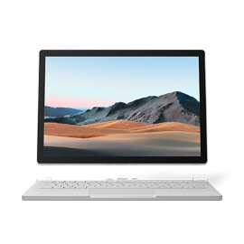
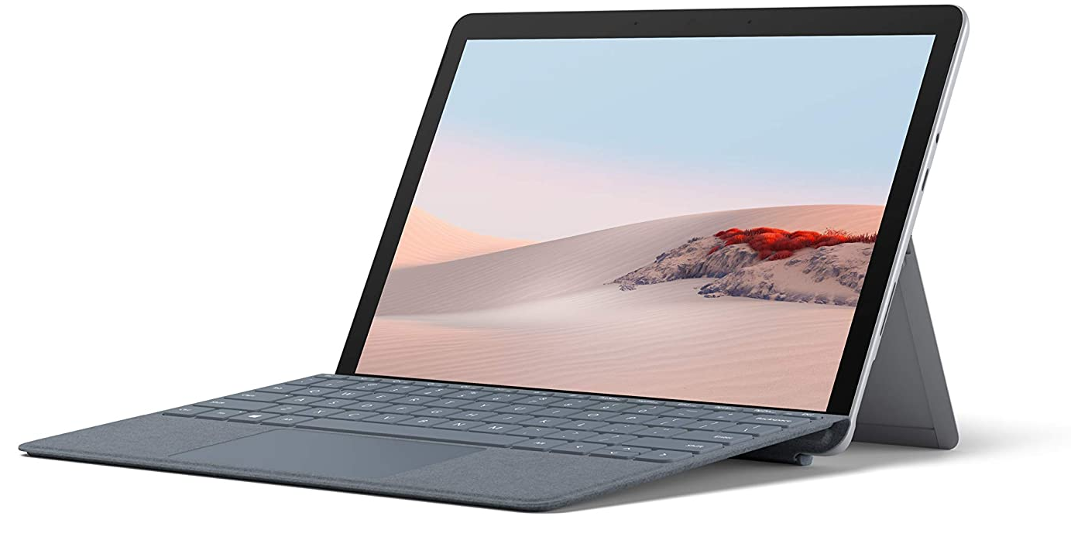
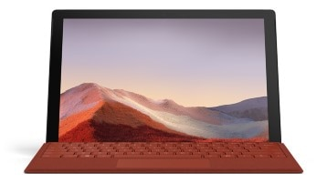
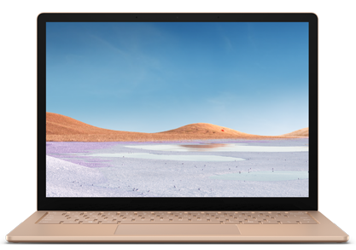

Customize your learning with the power and creativity of Surface
Surface Go
Surface Pro
Surface Book
Surface Laptop
Take work and fun on the go with a device that’s mobile and flexible enough to meet all your needs
Get the most out of your complimentary access to Office 365 on a device built to deliver a premium Office experience
Maximize your digital safety with built-in security and privacy features
Get up to
10% off
at aka.ms/surface
Students enjoy extra savings on a new Surface bundle to use with your
complimentary Office subscription available at aka.ms/eduoffice
Learn more about Surface at aka.ms/studentsurface

Slide 4
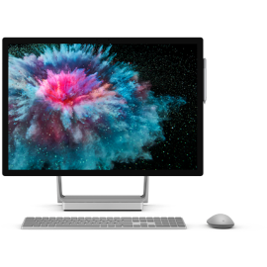
Find the perfect Surface device for you
Surface Go 2*
Surface Pro 5 LTE or Pro 7*
Surface Book 3*
Surface Laptop 3*
Improved speed for everyday tasks, shopping, browsing, emails, homework, and streaming movies, music, and shows
Versatile 2-in-1 laptop for working and playing your way, shopping, banking, on-screen writing, and streaming videos
Next-gen, pro-grade performance for graphic design, app development, video and social content creation, and gaming
Improved speed for everyday productivity, Microsoft 365, streaming music and shows, shopping, writing papers, and browsing
Display
10.5” PixelSense Display
1920 x 1280 (220 PPI)
Display
12.3” PixelSense Display
2736 x 1824 (267 PPI)
Display
13.5” or 15” PixelSense Display
3000 x 2000 or 3240 x 2160
Display
13.5” or 15” PixelSense Display
2496 x 1664 or 2496 x 1664
Memory
4GB or 8GB RAM
Memory
Pro 5: 4GB or 8GB RAM
Pro 7: 4GB, 8GB, or 16GB RAM
Memory
Up to 32GB RAM
Memory
8GB or 16GB RAM
Processor
Intel Pentium Gold Processor 4425Y
Processor
Pro 5: Intel Core 7th Gen i5
Pro 7: Intel Core 10th Gen i3, i5, or i7
Processor
Quad-core 10th Gen Intel Core i7
13.5” only: Intel Core i5
Processor
13.5”: Quad-core 10th Gen Intel Core i5 or i7
15”: AMD Ryzen 5 or 7
Storage*
Up to 128GB solid-state drive (SSD)
Storage*
Pro 5: Up to 256GB SSD
Pro 7: Up to 1TB SSD
Storage*
13.5”: Up to 1TB PCle SSD
15”: Up to 2TB PCle SSD
Storage*
128GB, 256GB, 512GB, or 1TB SSD
Battery life**
Up to 8.5 hours of local video playback
Battery life**
Up to 10.5 hours of typical device usage
Battery life**
13.5”: Up to 15.5 hours
15”: Up to 17.5 hours
Battery life**
Up to 11.5 hours of typical device usage
Graphics
Intel UHD Graphics 615
Graphics
Pro 5: Intel HD Graphics 620
Pro 7: Intel UHD Graphics (i3), Intel Iris Plus Graphics (i5, i7)
Graphics
NVIDIA GeForce GTX
13.5” only: Intel Iris Plus
Graphics
13.5”: Intel Iris Plus
15”: AMD Radeon Vega 9 or AMD Radeon RX Vega 11
Optional accessories
Surface Go Signature Type Cover
Surface Pen
Surface Dial
Optional accessories
Surface Pro Signature Type Cover
Surface Pro Type Cover
Surface Pen
Surface Dial
Optional accessories
Surface Pen
Surface Dial
Optional accessories
Surface Pen
Surface Dial
*Hard drive is only removable by skilled technician following Microsoft provided instructions.
**Battery life varies significantly with usage and settings.
Visit aka.ms/surface to explore other options
***System software and updates use significant storage space. Available storage is subject to change based on system software updates and apps usage. 1 GB = 1 billion bytes. See surface.com/storage for more details.
Not sure what you need?
Let us help find the best device for you at aka.ms/helpchoose

Slide 5














Download all the tools you need
with your complimentary subscription to Office 365
Centralize your school activities on a single digital hub with Microsoft Teams
Use powerful creative tools to tackle any assignment
Stay on top of your work with leading productivity apps
Word
PowerPoint
OneDrive
OneNote
Outlook
Excel
Start your studies right with complimentary access to Office 365

Slide 6


Start your Office 365 journey here
Download
Go to www.office.com and select Sign in.
Sign in with your Microsoft, work, or school account.
Follow the steps on the screen that match the type of account you signed in with.
Install
Depending on your browser, select Run (in Edge), Setup (in Chrome), or Save File (in Firefox).
If you see the User Account Control prompt that says, “Do you want to allow this app to make changes to your device?” select Yes.
The installation will be finished when you "You're all set! Office is installed now." Select Close.
Activate
Mobile Devices
To open an Office app, select the Start button (lower-left corner of your screen) and type the name of the Office app (like Word) and select its icon in the search results.
When the Office app opens, accept the license agreement. Office is activated and ready to use.
To activate Office on non-Microsoft devices follow the activation directions located on support.office.com.
To set up Office 365 on your phone or other mobile device, visit the install guide at support.office.com for instructions
Make life more organized, secure, and creative with Office 365

Slide 7
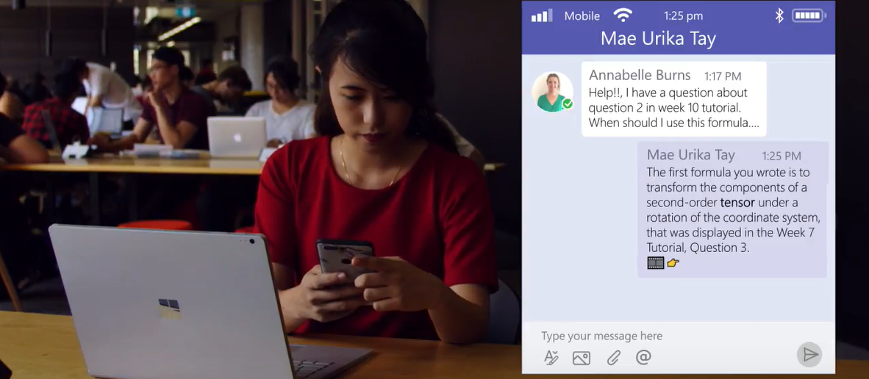
Bring conversations, assignments, and apps together in one digital hub with Microsoft Teams
Get started for free with your
complimentary subscription
Track assignments, lectures, and more
Collaborate on
group projects
Meet with your classmates or
professors
Organize notes in
a central place
Reminder: Send in assignment by 6pm tonight
Access the apps
you need
Get involved in the student community

Slide 8
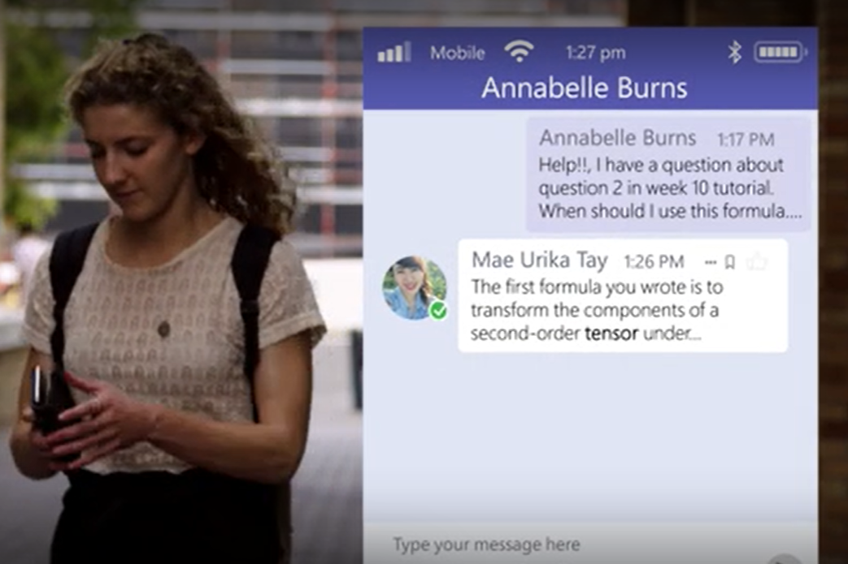

One hub for your complete
educational experience
Track assignments, lectures, and more
Store all your academic information in one highly secure location, and keep track of papers, assignments, study guides, and other course materials your professors share.
Collaborate on group projects
Upload live versions of documents so your group can make edits in one place. Access with your school account so you don’t have to use personal social accounts.
Meet with your classmates or professors
Use voice and video to meet with groups—including screen sharing, hand raising, and views like Together Mode. Communicate with peers and professors through chat.
Organize notes in a central place
Integrated with Teams, the OneNote app enables you to compile notes for classes in an organized notebook with color-coding, note-taking templates, and more.
Access the apps you need
Teams connects to hundreds of apps beyond Office 365. A few examples are Flipgrid for video sharing, Quizlet for studying, and Adobe Creative Cloud to share projects.
Get involved in the student community
Create teams for clubs, student government, and more. Use channels to organize the discussion and set up polls to get quick feedback or make group decisions.
See how fellow students are easily managing their social and academic lives
Annabelle Burns
“Whenever I’m stuck on a question, I know that there’s always an answer to be found on Teams. I don’t have to think as hard about how I’m going to find the answers and panic about missing a lecture because I know that I can always find the content.”
Mechanical & Manufacturing Engineering Student
Watch the video here
“As a student, it’s very useful for having everything in one area. It’s very easy to just message a professor and they usually respond quickly. It’s got assignments on there and I can share my screen. I work here on campus and it’s useful for having team meetings with coworkers on the other side of campus with the click of a button to have a video chat and show them what I’m looking at.”
Fabian Vargas
Aerospace Engineering Student
Watch the video here
Need any help with Teams? Visit aka.ms/StudentSupport

Slide 9


Skill up and get ahead now with the apps you need to succeed
  Use trusted, creative tools to tackle any assignment
  Design presentations, craft essays, and analyze data with powerful apps
  Create polished multimedia presentations using PowerPoint’s professional design capabilities
  Review your work, track changes, and refine your writing with built-in
  editing tools in Word
  Crunch the numbers with Excel and spot trends with graphs, color coding, and icons
  Stay organized with solutions that make college easier to handle
  Everything you need, where you can find it, when you need it
  Download the last notebook you’ll ever need—OneNote helps you organize class notes easily, all in one place
  Store up to 1TB of your work for free on OneDrive and don’t worry about losing your work
  Organize your day using Outlook and its intuitive mobile app for email, calendaring, and notifications
  Run your life on campus from a single digital hub
  Use Microsoft Teams for everything from contacting professors to social planning
  Connect with peers, share notes, and create groups—all without exchanging phone numbers or social handles
  Collaborate on group projects with video chatting and screen sharing
  Share and access class materials, files, and notes from virtually anywhere, anytime
  Get involved in the student community and keep control over your social life
  Easily track information throughout your entire academic journey

Slide 10

Grow your skills and accelerate
your academic success
  New to Office 365?
Find the Microsoft Teams learning path here and get a quick tour with our downloadable guide
Access trainings that show you the basics of any of the Office 365 apps here
Learn tips and tricks to make getting
started easier and explore the full Office Training Center
  Ready to get a head start?
Explore the wide variety of Office templates to get started with everything from creating newsletters, presentations, and reports to resumes and cover letters
Prove your skills to employers by earning badges and certifications on Microsoft Learn, tailored for you as a student. Visit aka.ms/learncert to explore certifications
  Go even further and level up your skills
  Get ready for your next job by building apps, exploring AI, and making the most of big data through Azure for Students
  Complete in our global tech competition, putting your knowledge into action and solving real-world challenges via Imagine Cup
  Apply to join the Learn Student Ambassador Community to help you learn, lead, and empower those around you. Get access to free tools, events, and more.
  Learn how to use Power Platform, a set of tools that streamline and digitize processes in the modern office:
Power BI
Gain data-driven insights in intuitive dashboards
Power Apps
Build custom no-code apps that suit your needs
Power Automate
Expedite day-to-day processes with flows
Power Virtual Agents
Easily build chatbots that engage conversationally
  Find support for any of these tools at aka.ms/StudentResources or the Student Help Center

Slide 11

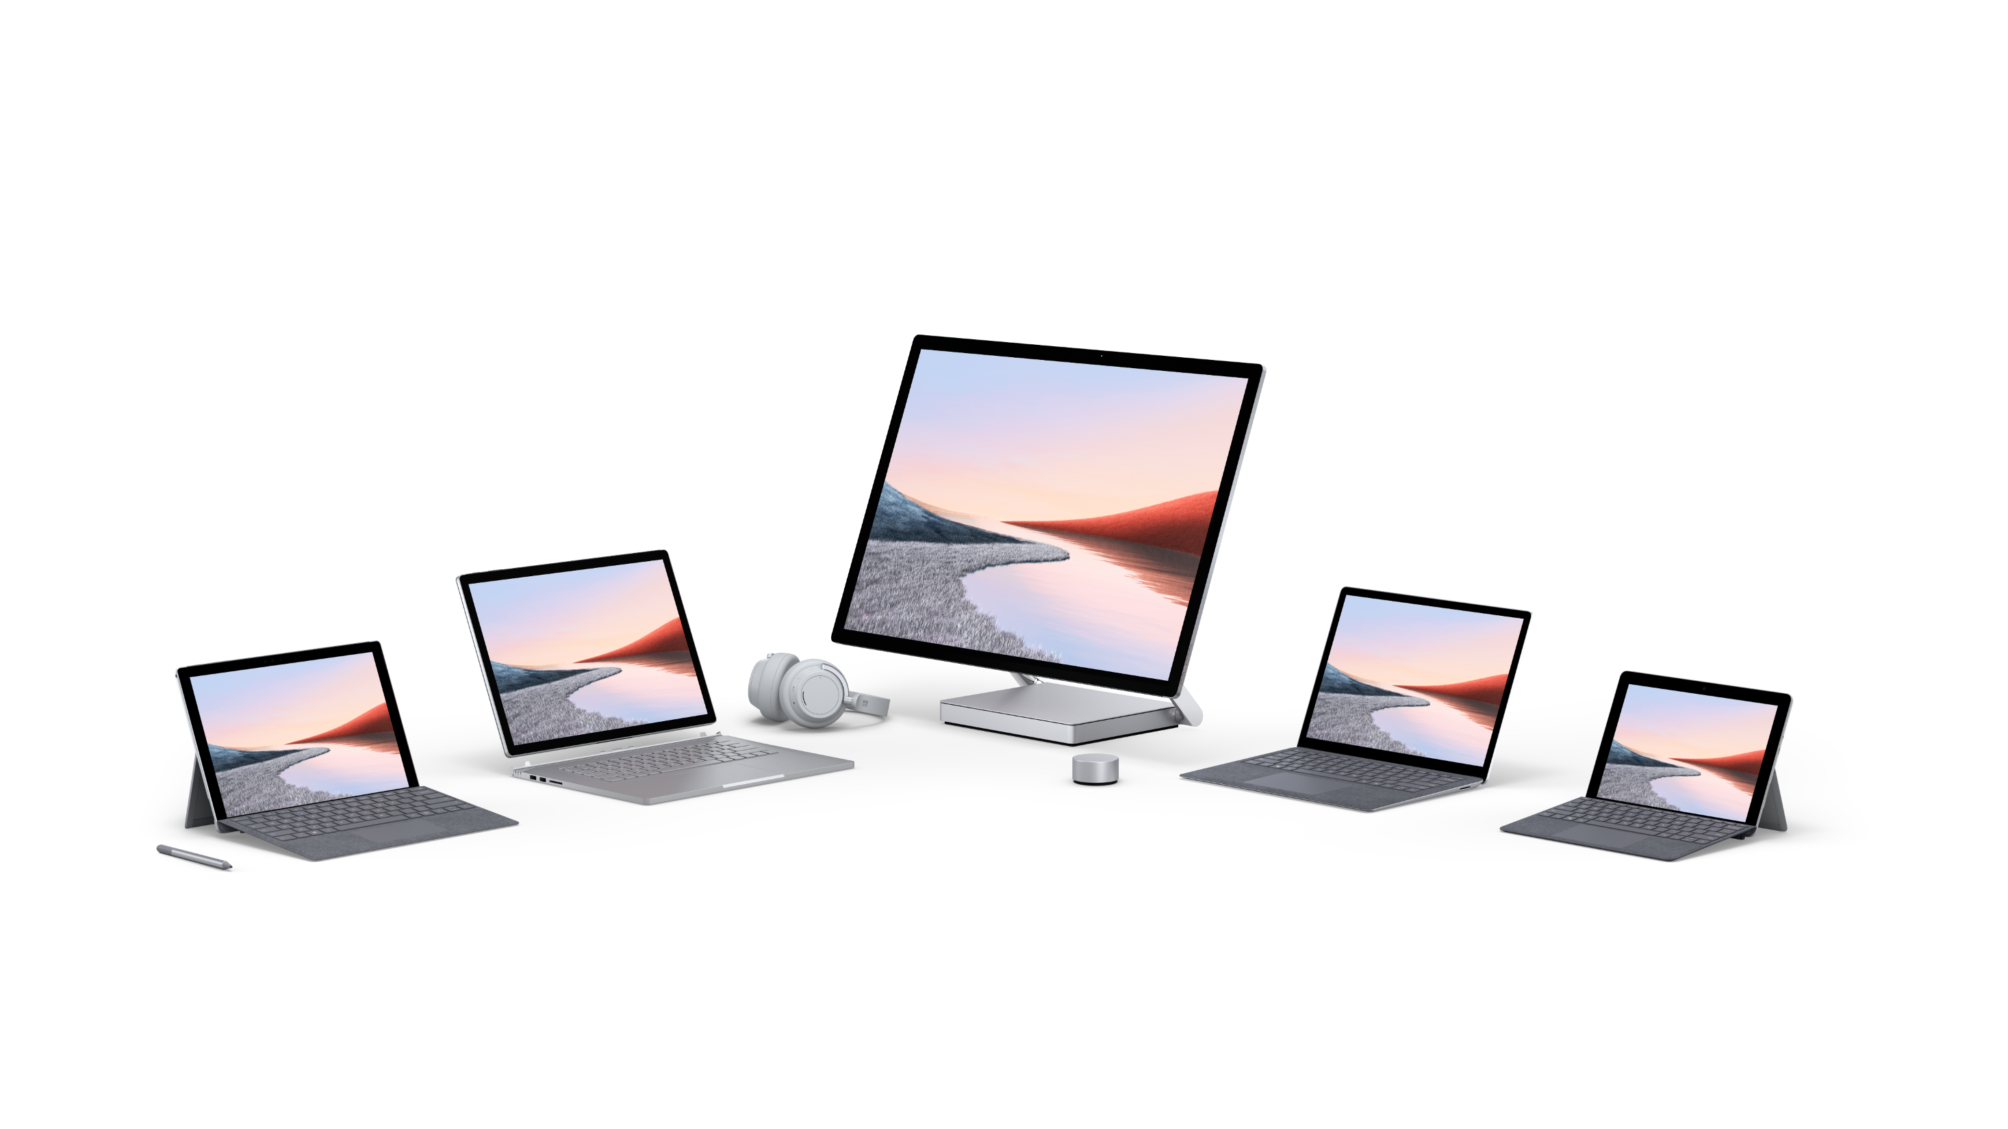
  Getting a new device for college?
Windows devices can help prepare you for success no matter where you are—on campus, at home, or on the go.
Maximize your creativity with Office 365 for free, using Word, PowerPoint, and OneNote—or choose from a wide range of Windows-compatible programs
Connect and collaborate with Microsoft Teams, easily sharing your work or chatting with peers and professors in a central, highly secure hub
Save all your assignments by backing up your files on OneDrive, letting you sync everything across multiple devices and recover work from the cloud
Surface devices help you get ahead and make the most of Windows and Office 365
Take handwritten notes, draw, and more using touch screens on all models and the versatile Surface Pen for precise digital inking
Get through all your classes without charging by relying on long-lasting battery life, including up to 17 hours on certain models
Choose the model that’s right for you, including 2-in-1 designs that flip between tablet and laptop, and devices with LTE capabilities

Slide 12


Get started quickly and easily
Sign in with Microsoft
Get personal access to all things Microsoft with a single, highly secure sign-on, plus get free OneDrive storage to help you move your files to your new PC. Sign in with:
Your student account
A Microsoft account (check if you already have one here)
Any email
Move over your files
There's no need to leave your files or browser favorites behind. Bring them with you to your new device using one of the below options.
Option 1: OneDrive (Recommended)
Option 2: Backup & restore feature
Option 3: External storage device
Install popular apps
Tips & Tricks
Download your favorite apps you’ll be using in your daily life, including Teams and Office 365, and visit the Microsoft Store to download other apps including…
Social media
Games and entertainment
And much more…
For advice about making the most of Windows 10 on your new Surface device, visit microsoft.com/tips
Add your university web store here if relevant
Visit <our web portal> to explore available devices and get started downloading important software.
Organize your life in and out of the classroom with Windows devices

